Slide 1
Innovation Challenge Hackathon
Microsoft Garage
November 2025
Presented by
Codigo Facilito
Team 4
Codigo Facilito
November
2025

Slide 2
Civic Chat
The Challenge:
While public information is abundant, it often remains inaccessible and difficult to interpret.
Citizens encounter barriers such as overly technical language, fragmented datasets, and static communication channels that fail to address individual concerns.
These obstacles lead to misinformation, fuel apathy, and deepen the disconnect from local community life.
Codigo Facilito
November
2025

Slide 3
App Development
Our Mission:
Develop a solution using Microsoft Azure
November 10th -27th
Civic Pulse is a civic engagement platform powered by Multi-Agent AI and Official Government data.
It empowers Citizens, Community Leaders, and Public Officials to navigate complex policies, access local services and events, and engage in a secure, disinformation-free community forum.
Codigo Facilito
November
2025

Slide 4
Meet the team
Carlos Nieto
Fernando Itzama
Roberto Valenzuela
Front End Developer
Data Eng.
Sr. Sw. & Data Science
Kevin Uc
Franziola Chiu
Data Analyst
Program Manager
Codigo Facilito
November
2025

Slide 5
Roles
Carly Chavez
MVP Consultant
Kev Uc
Carlos Nieto
Fernando Itzama
Roberto Valenzuela
Franziola Chiu
Product Manager & Azure Architect
Solution Architect
Front-End Developer
Data Eng.
Azure Architect
Program Manager
Product definition, requirements and Agentic Framework & Implementation & Product Delivery
Developed the Application and integrated with back-end
Designed the Knowledge base
Designed the Azure Infrastructure and Software Integration
Communication, Presentation & Front-End Application QA
Codigo Facilito
November
2025

Slide 6
Innovation Journey
1
2
3
4
Process:
Select the Challenge
Project Planning
Build & Test
Integration, Presentation, Continuous Improvement
Challenge selection, Team Introductions and identify strengths and weaknesses
Define the Project scope and assign workload and roles. Begin work, clarify questions and realign
Deliver the implementation plan for the partnership.
Consolidate the Front-end, Back-End and Knowledge Source Repository
Codigo Facilito
November
2025

Slide 7
Modern Technology
Made with:
Deployment Front-End | GitHub Actions, Azure Container Registry, Azure App Service Next.js, Static Web Apps
Back-End | Python FastAPI, Semantic Kernel. Serverless Compute: Azure Functions
AI Services | Open AI, Text-to-Speech, Translator, Content Moderator
Data Sources | INEGI, Municipal, State and Federal Government sources
Azure Infrastructure | Data & Storage: Blob Storage, Cosmos DB Search & Maps: AI Search, Maps Messaging & Events: Event Grid, Service Bus Monitoring & Safety: Communication Services, Content Safety, Monitor & App. Insights
Codigo Facilito
November
2025

Slide 8

App Development
We Deliver:
Designed to be inclusive and easy to replicate, providing essential information to people with disabilities, language barriers, or limited technical knowledge.
Codigo Facilito
November
2025

Slide 9
Solutions
How we transformed into:
Understand Policies | Educator Agent uses Azure OpenAI and Semantic Kernel to explain concepts and ballots neutrally.
Safe-forum space | Provide a moderated, safe-discussion space where Citizens can engage in community related topics, share concerns, and interact constructively.
Personalized Civic involvement | Notification Agent filters events and alerts based on geographical location and profile interests.
Codigo Facilito
November
2025

Slide 10
Solutions (Cont.)
How we transformed into:
Trusted and Verified Government data | Ingestion Agent frequently updates the knowledge to ensure accuracy and freshness.
Aggregating fragmented Public data | Ingestion Agent + RAG Agent consolidate diverse datasets into a unified civic knowledge base within the engagement platform.
Codigo Facilito
November
2025

Slide 11
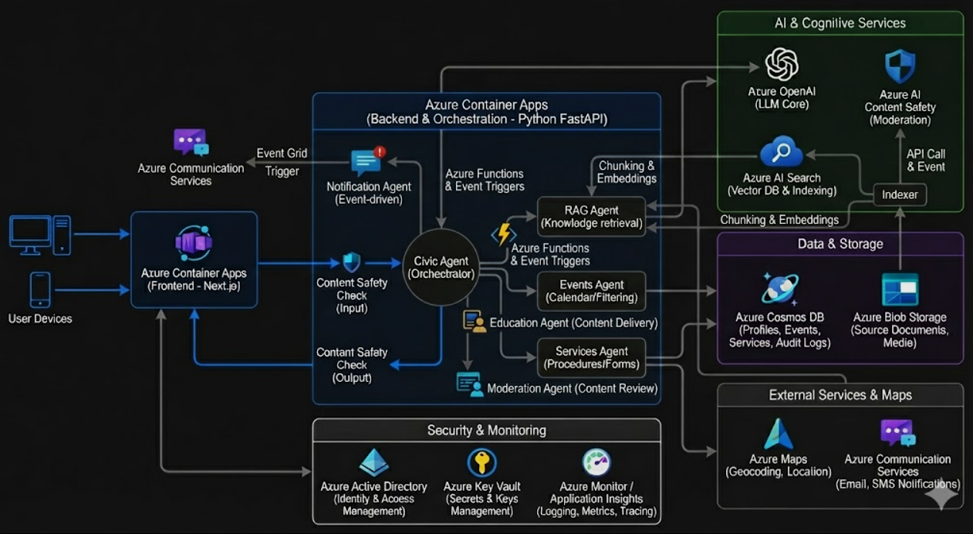
Azure Architecture
Powered by:
Codigo Facilito
November
2025

Slide 12
We use AI Responsibly
Our values:
Fairness
Agents provide neutral explanations free from political or ideological bias.
Reliability and safety
All responses rely on verified government sources through RAG.
Privacy and security
We collect only the minimum required data, and notifications operate under explicit user consent.
Inclusiveness
Translation, multilingual support, and Text-to-Speech ensure access for all users.
Transparency
Answer indicate the agent involved, whether RAG was used, and citations with sources.
Accountability
The Moderation Agent logs key decisions and enforces clear rules to maintain a safe and auditable environment.
Codigo Facilito
November
2025

Slide 13


A diverse team with a passion for Innovative Solutions
5
200+
Our accomplishments:
Credentials
DP-100
AI-102
Mentored by MVP Carly Chavez
Data Scientist
Associate
AI Engineer
Associate
PL-900
DP-900
Power Platform Fundamentals
Azure Data Fundamentals
Team
Applied Skills
Azure Services, Storage,
Agent Orchestration, RAG
Hours of Training
Codigo Facilito
November
2025

Slide 14
Code Repository:
“In proportion as the structure of a Government gives force to public opinion, it is essential that public opinion should be enlightened.”
George Washington,
Farewell Address (1796)
GitHub
Codigo Facilito
November
2025

Slide 15
Thank you
Stay in touch
https://codigofacilito.com
Codigo Facilito
November
2025

